Slide 1

3rd Iteration
By
Aishwarya Viswatmula
Bharat M Bhavsar
Gurleen Chawla
Jay Tarun Chheda
Vishal Kankanala
(Group 5)

Slide 2
Problem Statement
To get connected to unknown UTD students via UTD mail address or social networking (Facebook®/ LinkedIn®)
To locate places on UTD campus and to get familiar with different locations.
To get important information regarding offices and places such as contact details, office hours, etc.
To track the friend’s location on campus map without contacting by means of messaging or calling

Slide 3
Summary of 1st Iteration
Created the database
Integrating with Google Maps® API
User updates his location and gets other user’s location too.
Server Side: Data is sent to server in AJAX call it replies with other’s location

Slide 4
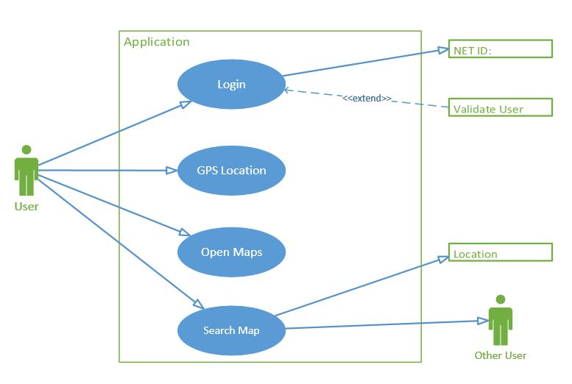
Use case of 1st Iteration

Slide 5
Summary of 2nd Iteration
Login & Registration Page
Search Box
Privacy Settings
Link to Facebook® and LinkedIn® profiles
Added few more locations to the map
Restructuring of code into 3 tier architectural design

Slide 6
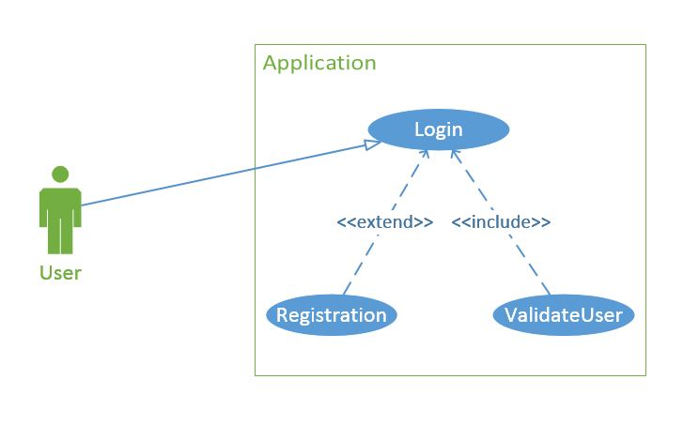
Use case of 2nd Iteration: Login & Registration

Slide 7
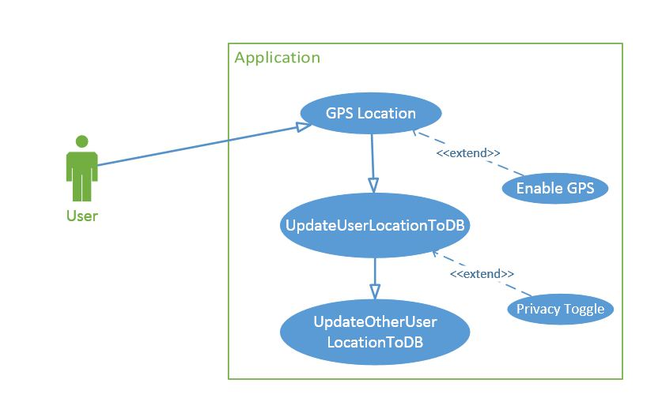
Use case of 2nd Iteration: Update Location

Slide 8
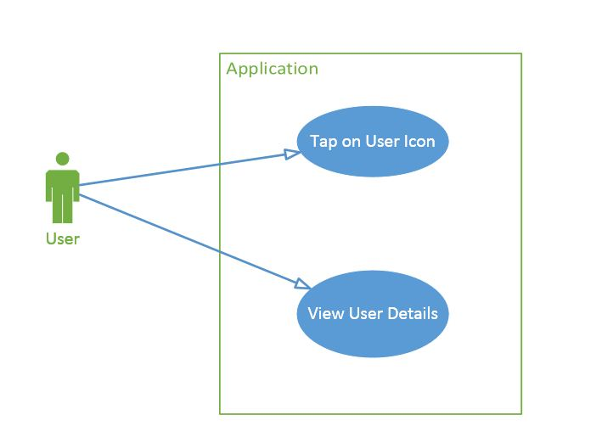
Use case of 2nd Iteration: View User Details

Slide 9
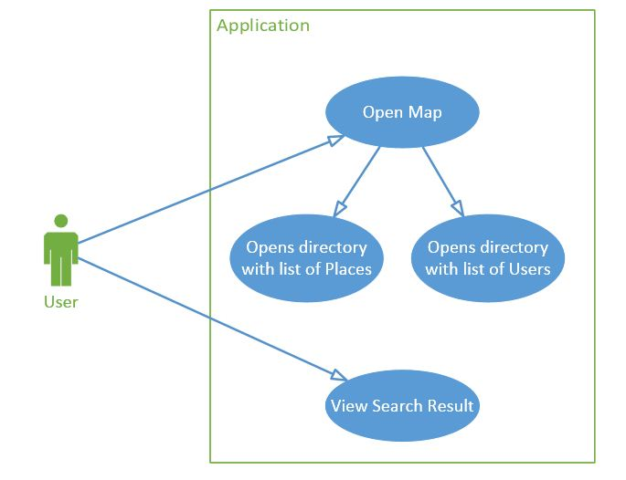
Use case of 2nd Iteration: Search

Slide 10
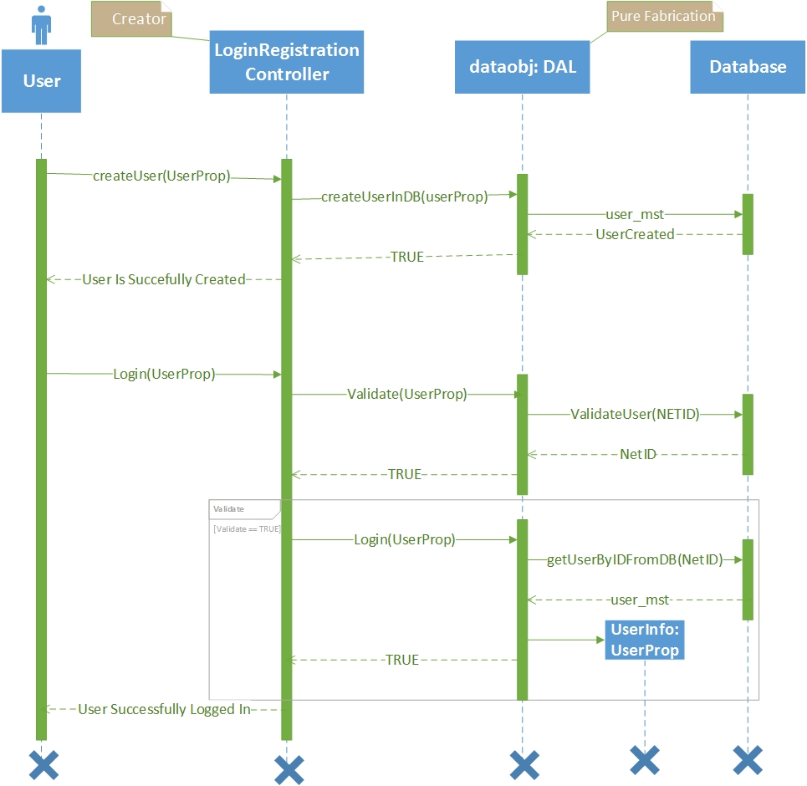
3rd Iteration-Change w.r.t. Feedback?

Slide 11
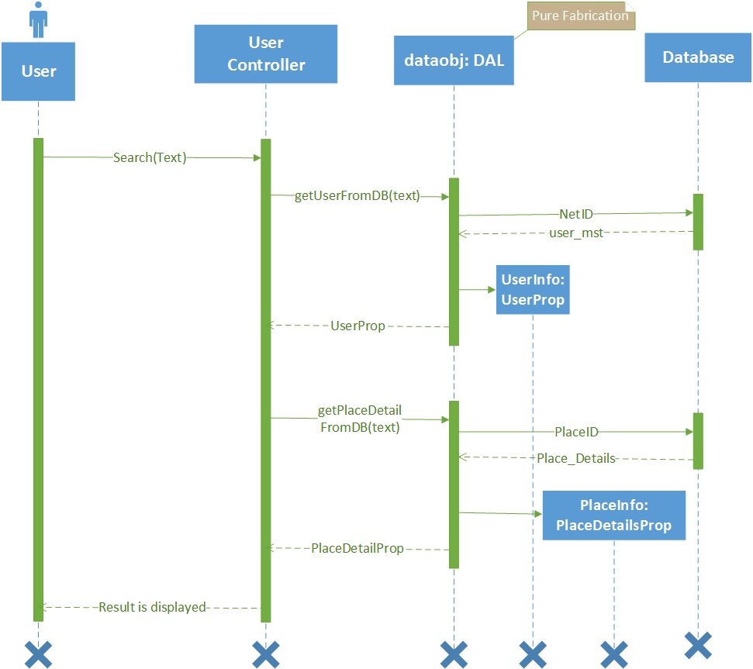
3rd Iteration -Change w.r.t. Feedback?

Slide 12
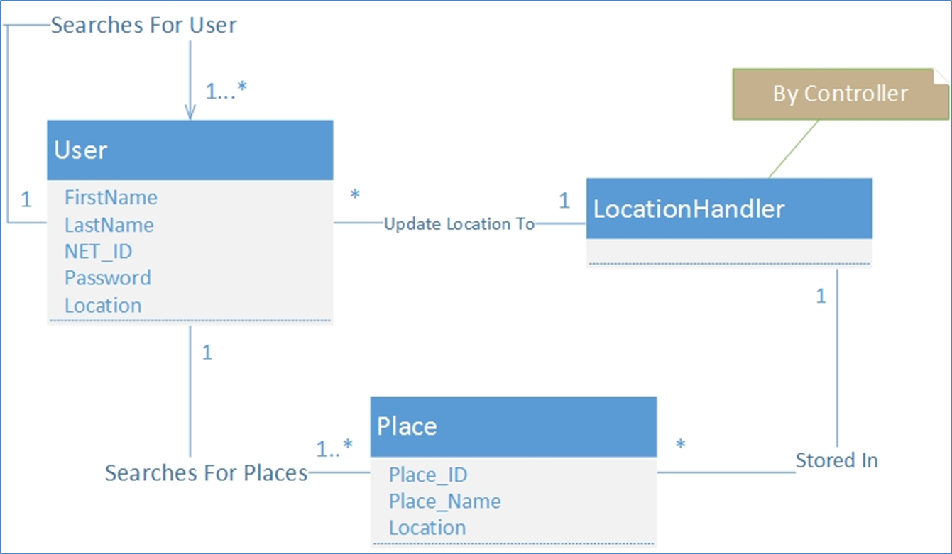
Final Domain Model

Slide 13
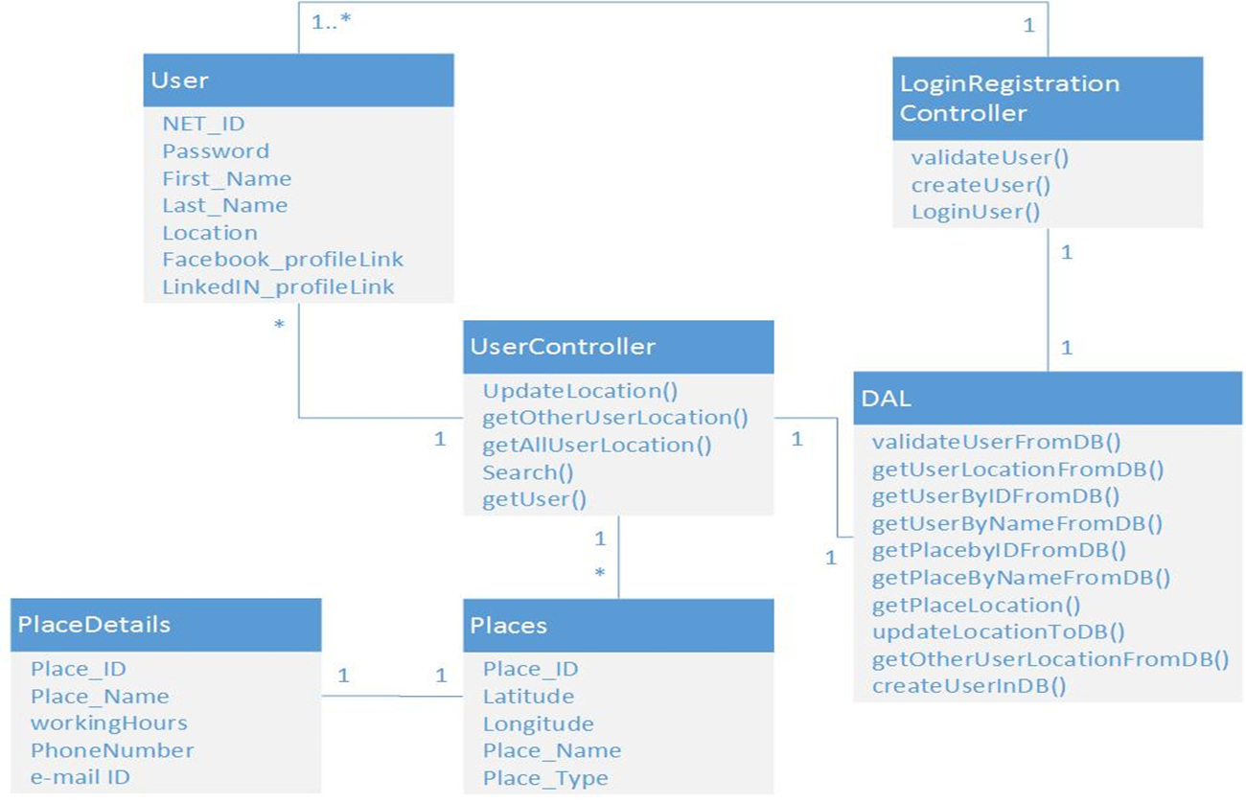
Overall Class Diagram

Slide 14
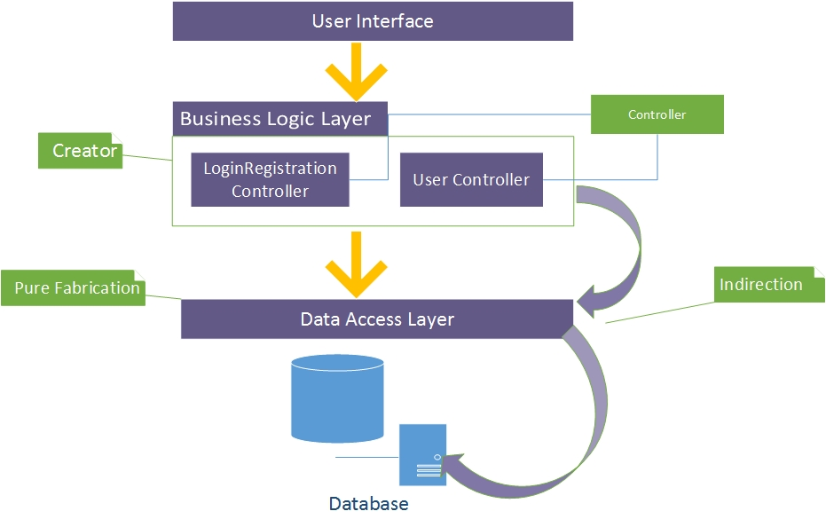
3rd Iteration-GRASP Patterns

Slide 15
3rd Iteration-Observer Pattern
Here, DAL is subject (Publisher) which sends all user location updates to all active users.
Active users are the Observers (subscribers) who receive location updates of all other users whose privacy status is off.

Slide 16
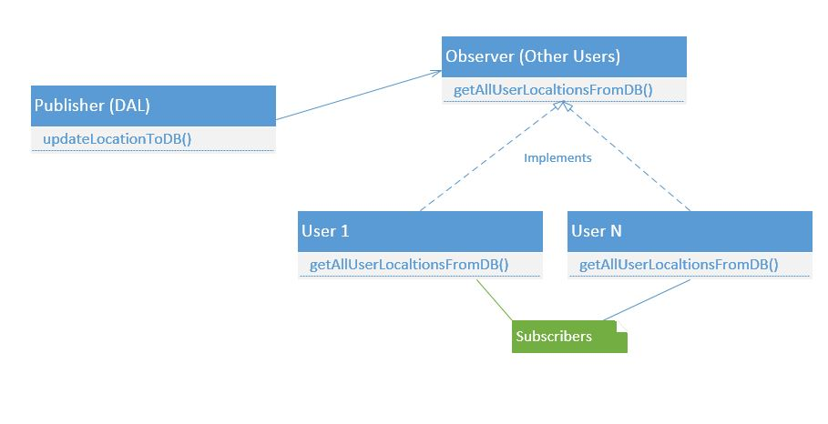
Observer Pattern…Diagram

Slide 17
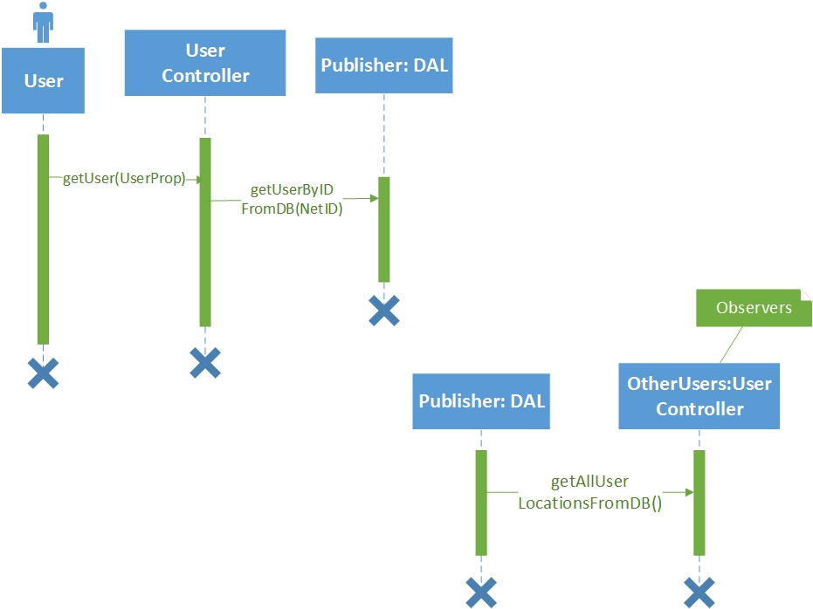
Observer Pattern: Interaction Diagram

Slide 18
Testing
We needed to test the functionality of our application at different stages. The modules that were tested are:
1. Login & Registration.
2. View user’s location.
3. View other users’ location.
4. View different locations on Map.
5. Search for users and locations.
6. Privacy Settings.

Slide 19
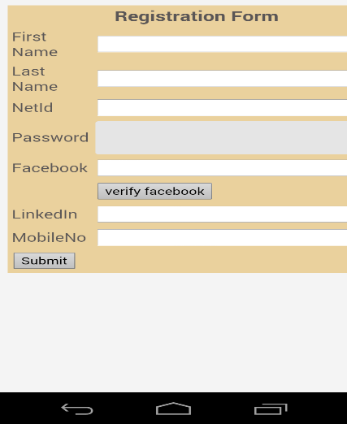
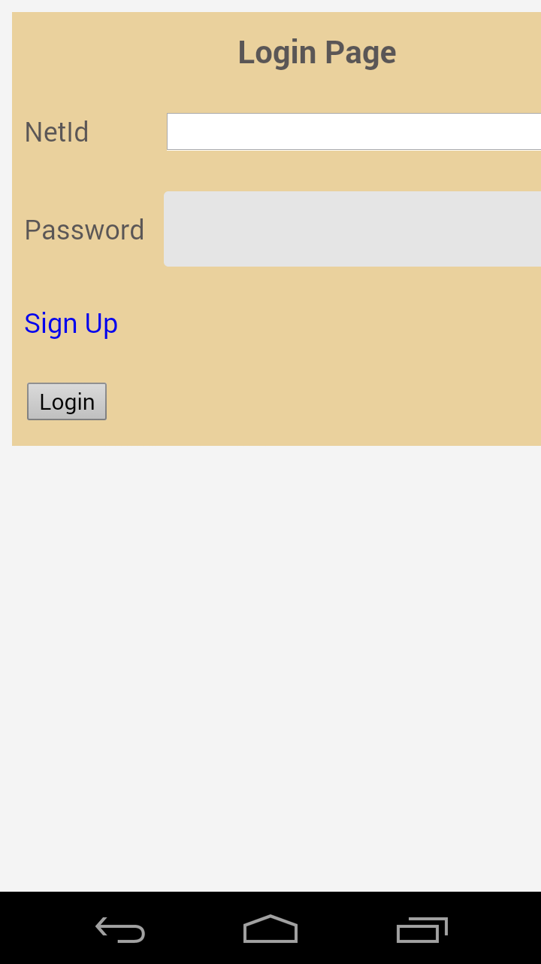
Screen Shots

Slide 20
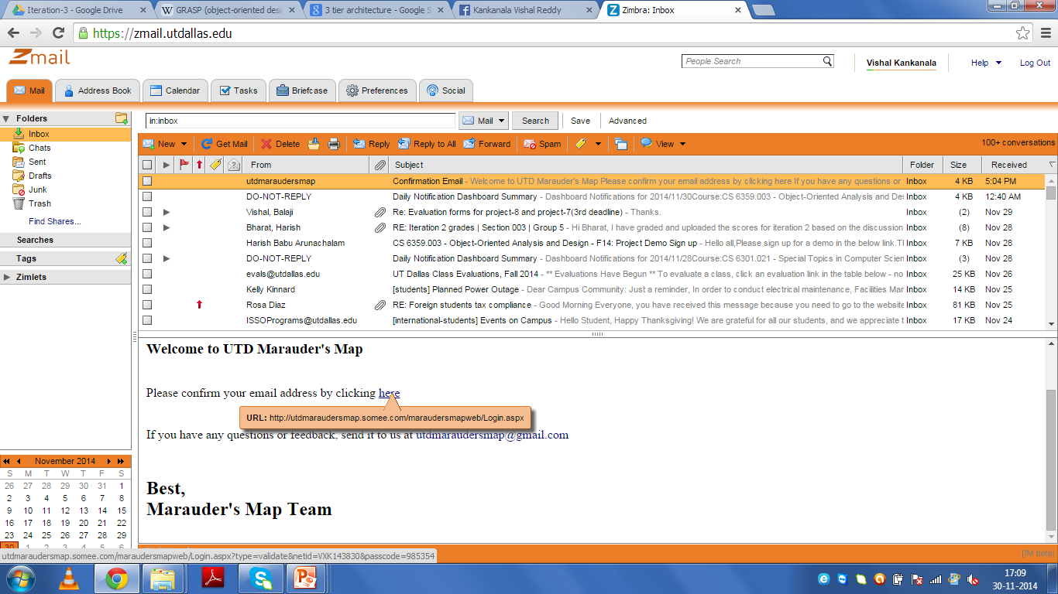
Screen Shots

Slide 21
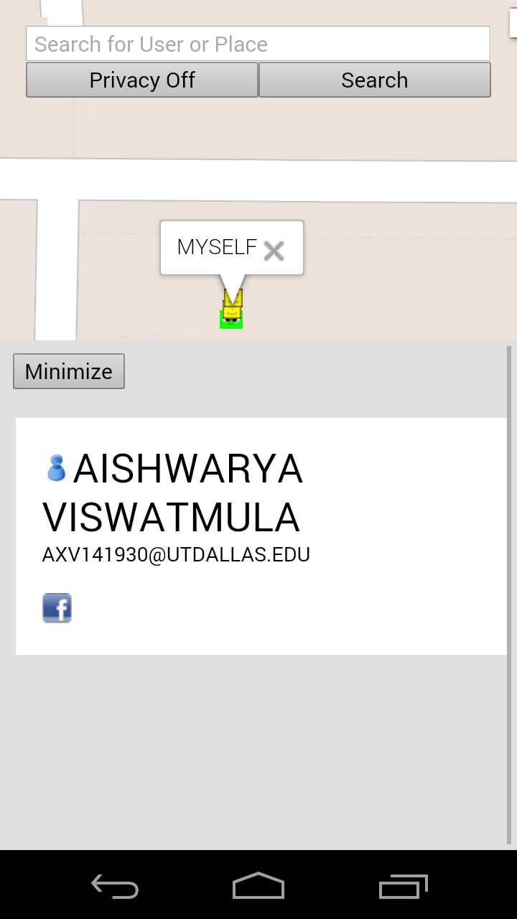
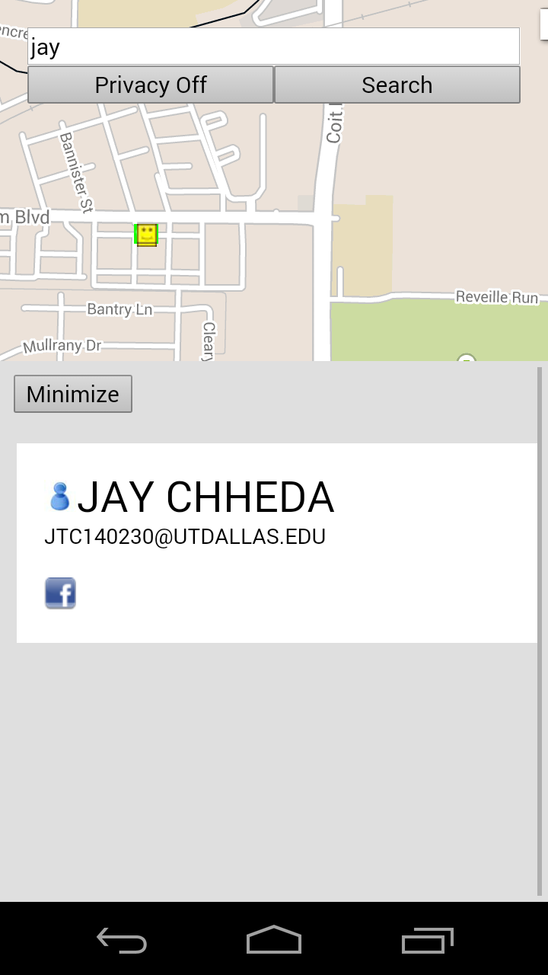
Screen Shots

Slide 22
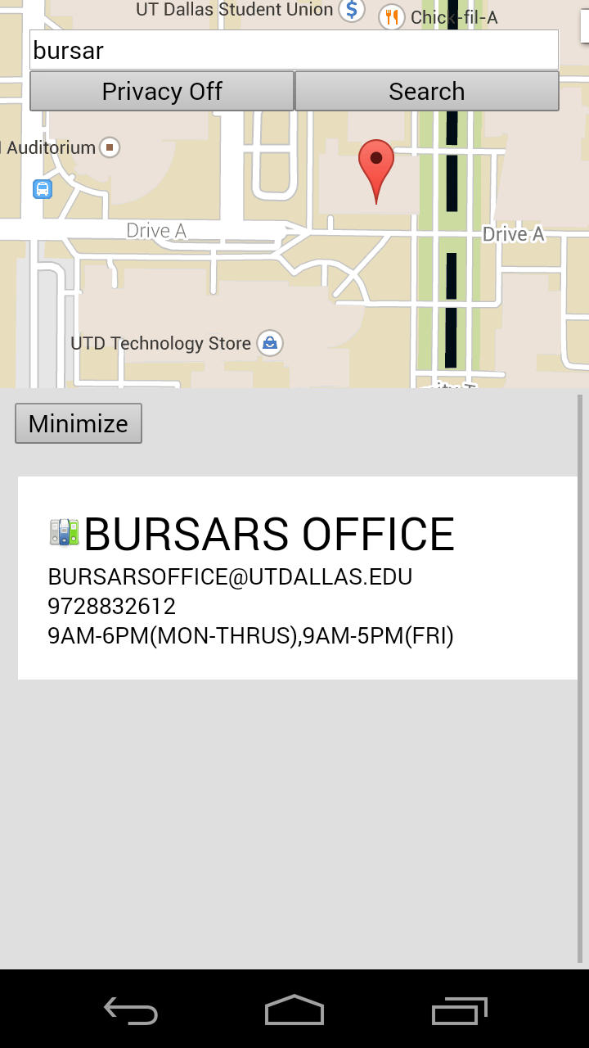
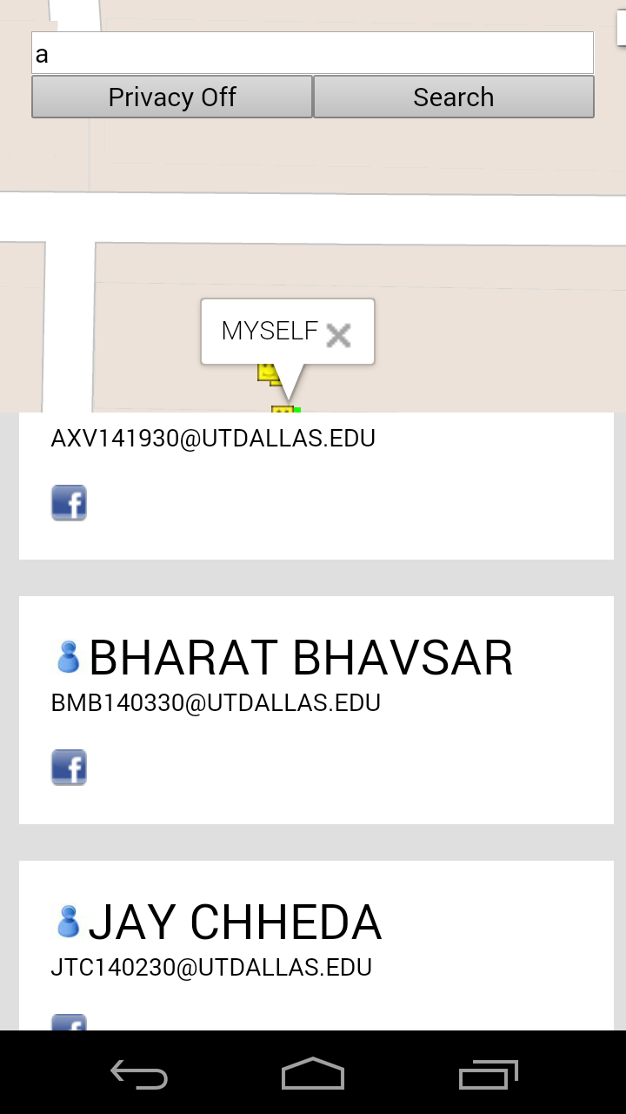
Screen Shots

Slide 23
Summary of 3rd Iteration
Changes in S.S.D w.r.t feedback in Iteration 2
Comprehensive work of GRASP patterns
Design Patterns
Added more places and dummy users to the Database
Testing
Final review & documentation

Slide 24
Proposed Timeline

Slide 25
Executed Timeline

Slide 26
Lesson learnt
Advantages of Agile methodology(over waterfall)
Iterative approach
How to simplify big hard problem in easy small problems
Managing individual priority & teamwork
Application of OOAD principles we learnt in class
Role of Feedback (Prof. and TA)

Slide 27
What we planned and what we achieved.
What we achieved
Track people in real time mode
Display details of important places on request
Privacy settings
Search for people(Other Users)
Connect with people through Facebook® and LinkedIn®
What we have not implemented
Group settings
Separate profile for student and professor
More details like classroom location.

Slide 28

Any Questions?
Mischief Managed!
Thank you!

